Slide 1
Azure Data Warehouse In-A-Day
01.Introduction to SQL DW
Steve Young - Data & AI CSA
Rebecca Young - Data & AI CSA

Slide 2
Presentation Objectives
01 Introduction to SQL DW
Introduction to the Day and Logistics
Washrooms, Lunch, EOD, Azure Pass, Keep DW Small
How SQL DW fits into the Azure Data Services
SQL DW in the modern data solution architecture
Various Important Features and definitions

Slide 3
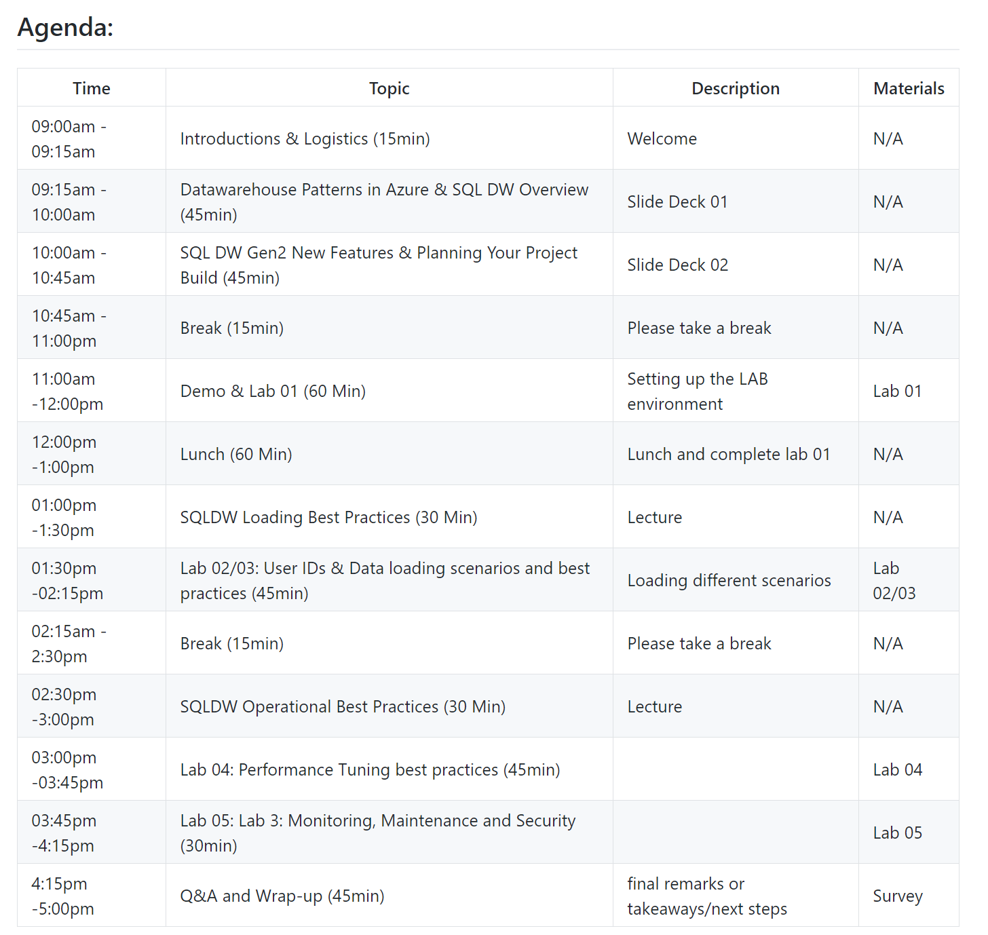
Agenda
Notes:
Lets review the agenda for today

Slide 4
Important Info
AzurePass Instructions - https://www.microsoftazurepass.com/Home/HowTo
Azure Pass - https://www.microsoftazurepass.com/
File Location - https://github.com/steveyoungca/SQLDWinaDayWorkshop
Notes:
Download the files to a folder on your desktop
DEMO, Lets do that first, and also walk through what is in the Repo
The Azure KEY will not be there tomorrow.

Slide 5

Azure and the Modern Data Estate
Notes:
Before we go too far into the tool
Lets cover the environment that SQL DW operates

Slide 6































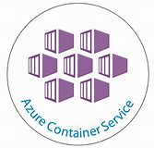






















Modern Environment will have many tools → Use the open source tools you like
DevOps
Management
Applications
App frameworks
& tools
Databases &
middleware
Infrastructure
Notes:
Embracing what customers use
Open Source tools
Not just Microsoft tools anymore, nor is it on prem
Some organizations play in all the clouds and all the data platforms
No longer silo even in the on prem

Slide 7
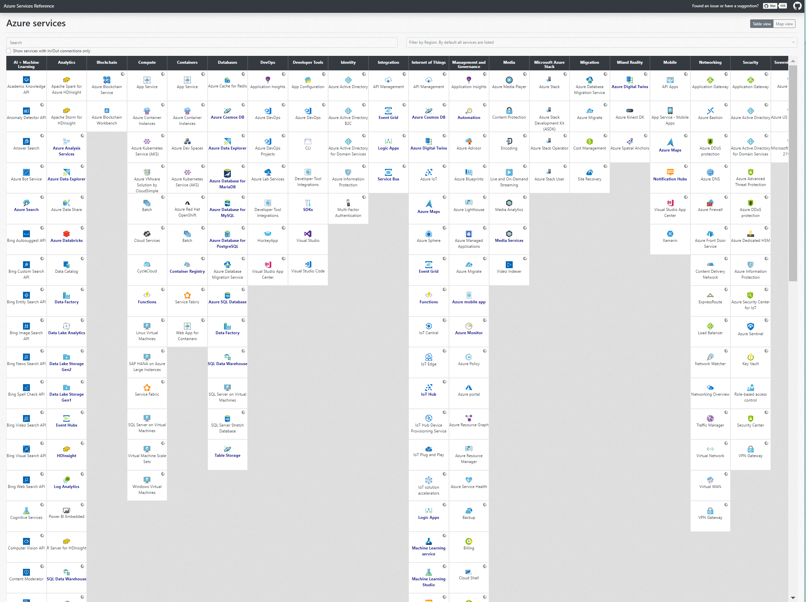
https://nnmer.github.io/azure-services-map/dist/
Anton Romanov -https://github.com/nnmer
Azure Services Map
Notes:
Even when you look at Azure, there are so many technologies, difficult to make the right choices
What do you choose?
DEMO – Go to site
Give credit to the community

Slide 8


Moving up the stack
Hy
Hybrid cloud
Customized
Commoditized
On-premises
Private cloud
infrastructure
as a service (Iaas)
Public cloud
infrastructure
as a service (IaaS)
Platform
as a service
(PaaS)
Software
as a service
(SaaS)
Abstraction
Customized
Commoditized
Data
Data
Data
Data
Data
Responsibility
Applications
Applications
Applications
Applications
Applications
Partner IT
Runtime
Runtime
Runtime
Runtime
Runtime
Middleware
Middleware
Middleware
Middleware
Middleware
Cloud
provider
OS
OS
OS
OS
OS
Virtualization
Virtualization
Virtualization
Virtualization
Virtualization
Servers
Servers
Servers
Servers
Servers
Storage
Storage
Storage
Storage
Storage
Networking
Networking
Networking
Networking
Networking
Notes:
You will see here the transition pattern from on prem to hybrid to cloud
This describes four distinct models of computing delivery. The colors and icons represent how each computing service is provided to the customer. Those in green or with the Windows icon must be provided by the customer, those in blue or with the cloud icons are provided by the cloud vendor.
Beginning on the left we have on-premises, or the legacy delivery model of computing infrastructure where the customer manages all services
As we move to the right, the private cloud with Windows Azure pack offers automated server and storage management
Public cloud Infrastructure as a service or IaaS is the next model, virtualization, servers, and storage are provided by the cloud vendor
With public cloud platform as a service or PaaS, the majority of services are managed by the cloud vendor, allowing the IT department to focus on just the applications and data. This enables more time spent solving business problems and improving applications rather than running infrastructure.
Finally we have software as a service, or SaaS, in this model the IT department only needs to manage the data within the applications and all other components are provided as a service. This model is perfect for IT workloads that don’t provide a business advantage from running them internally. Collaboration with email and SharePoint, CRM, etc.
Hybrid cloud is a model that spans all of these models, taking advantage of the benefits of each.

Slide 9
Cloud principles
Freedom of choice
Marketplaces
Cloud Inspired Infrastructure
Multi Vendor
Hybrid
Hyper scale
Self-service
Build in and on top of Security
Build in Compliancy
Automation
Continuous Change
Software defined
Scalable
Pay per Use
Lock in Reduction
Open- and closed source
Notes:
This was from Skype daily calling minutes metric

Slide 10
Saving cost
Inactivity
Period
Compute
t
On and Off
Growing Fast
Unpredictable Bursting
Predictable Bursting
24x7 Steady
Capacity Needed (Max + 20%)
Save
20-30%
Capacity Needed (Max + 20%)
Save
60-80%
S M T W T F S
J F M A M J J A S O N D
On and Off
(30%)
Growing Fast
(15%)
Unpredictable Bursting
(25%)
Predictable Bursting
(20%)
24x7 Steady
(10%)
Your Application Portfolio – What Does it Look Like..?
Notes:
Use each section and talk about each
For this slide – I will put this as having the ability to save.
Open up new workloads
But cheaper than hosting on prem as your grow – ability to scale when you need is the most important part of saving
On and off – like we will do with SQL DW in your azure pass accounts

Slide 11































































Platform Services
Security & Management
Hybrid
Cloud
Media & CDN
Application Platform
Data
Security Center
SQL
Database
Azure AD
Health Monitoring
Media Services
Media Analytics
Content Delivery
Network
Web
Apps
Mobile
Apps
SQL Data
Warehouse
DocumentDB
Portal
AD Privileged
Identity
Management
Azure Active
Directory
Integration
SQL Server
Stretch Database
Redis
Cache
Storage
Tables
Azure
Search
API
Apps
Cloud
Services
Azure AD
B2C
API
Management
BizTalk
Services
Domain Services
Service
Fabric
Notification
Hubs
Intelligence
Multi-Factor
Authentication
Logic
Apps
Service Bus
Functions
Cognitive Services
Bot Framework
Cortana
Backup
Automation
Developer Services
Analytics & IoT
Operational
Analytics
Compute Services
Scheduler
HDInsight
Machine
Learning
Stream Analytics
Container
Service
VM
Scale Sets
Visual Studio
Mobile
Engagement
Import/Export
Key Vault
Data
Catalog
Data Lake
Analytics Service
Data Lake Store
Store/
Marketplace
Batch
RemoteApp
VS Team Services
Xamarin
Azure Site
Recovery
Application
Insights
HockeyApp
IoT Hub
Event
Hubs
Data
Factory
Power BI
Embedded
VM Image Gallery
& VM Depot
Dev/Test Lab
StorSimple
Infrastructure Services
Compute
Storage
Networking
Virtual Machines
Containers
Blob
Queues
Files
Disks
Virtual Network
Load Balancer
DNS
Express
Route
Traffic Manager
VPN Gateway
App
Gateway
Datacenter Infrastructure
Notes:
SQL Operates in this environment – Part of the entire infrastructure
Security, Blob storage, ADF, AI, Storage, compute Over the infrastructure

Slide 12
Data services
SQL
Database
DocumentDB
Media & CDN
Data
Database as a service
Data
Warehouse
MY APP
SQL/no-SQL data stores
Developer services
Big Data capabilities
Storage
Tables
Integration
Search
Azure
Search
Caching
Data
Identity & security
Redis
Cache
Notes:
Data is one part of the whole.
We are going to focus on these areas in our talk today

Slide 13














Microsoft Azure BI & Analytics services portfolio
Devices | Device Connectivity | Storage | Analytics | Presentation & Action
` | IoT Hub | SQL Database | Machine Learning | App Service
 | Event Hub | Table/Blob Storage | Stream Analytics | Power BI
 | Service Bus | DocumentDB | HDInsight | Notification Hubs
 | External Data Sources | 3rd party Databases | Data Factory | Mobile Services
 |  |  | Data Lake | BizTalk Services
{ }
Notes:
This is the main service portfolio, we will see how these combine into different delivery models or as
we call them, Data Solution Architectures
Divided up into these areas. Devices, ……..

Slide 14
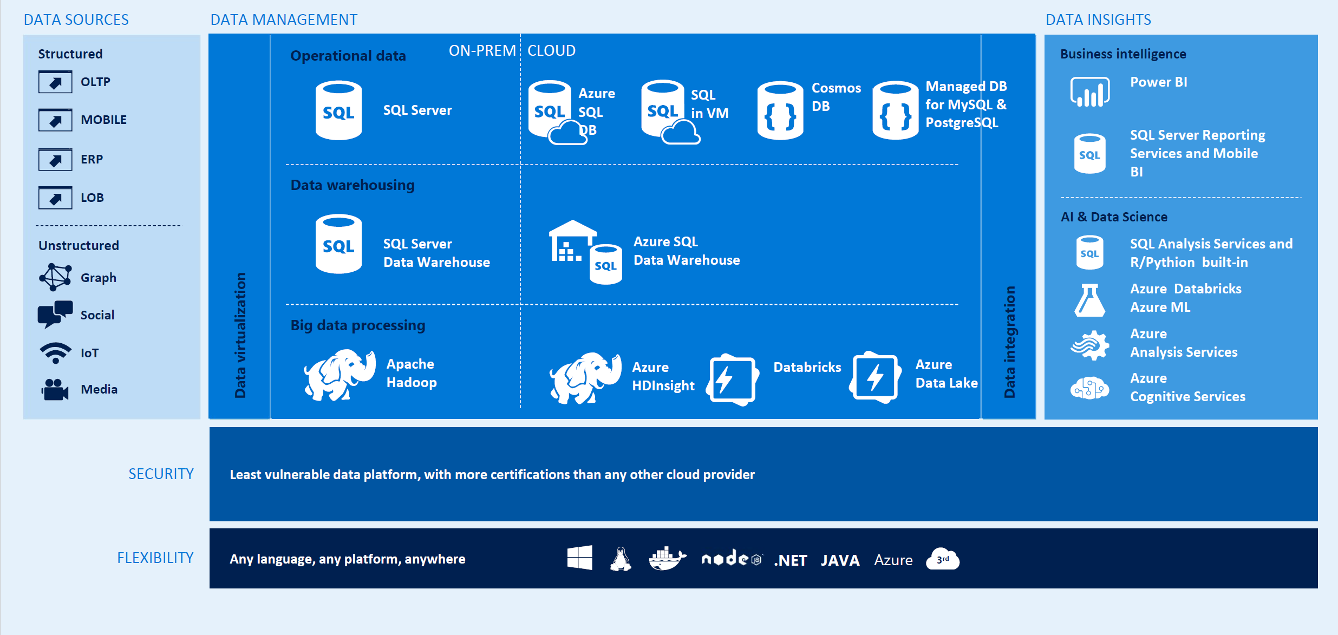

Azure and Data Estate Data View
Notes:
I like using this diagram with many of my presentations. The solution is some combination of the following
We will combine them into the following “Pick List”
As you come up with solutions, you pick and choose from this list
This is limited.

Slide 15
Modern Data Solution Architectures
Notes:
Lets look at some Solution Architectures

Slide 16
cloud Data Warehouse
INGEST
STORE
PREP & TRAIN
MODEL & SERVE
Files (unstructured)
PolyBase
Azure Data Factory
Azure Blob Storage
Azure SQL Data Warehouse
Azure Analysis Services
Power BI
Business/custom apps
(structured)
Microsoft Azure also supports other Big Data services like Azure HDInsight and Azure Data Lake to allow customers to tailor the above architecture to meet their unique needs.
Notes:
You see the pattern here,
Source data, ingested using a process, stored in an intermediary fashion,
ELT, into a database, SQL DW in our case, then served up into SSAS and consumed by end user apps
We will talk about load in a bit. Hit the databases with queries, or scale that up into a Analytical platform

Slide 17


Modern Data Warehouse
INGEST
STORE
PREP & TRAIN
MODEL & SERVE
Logs (unstructured)
Azure Databricks
Media (unstructured)
PolyBase
Files (unstructured)
Azure Data Factory
Azure Blob Storage
Azure SQL Data Warehouse
Azure Analysis Services
Power BI
Business/custom apps
(structured)
Microsoft Azure also supports other Big Data services like Azure HDInsight and Azure Data Lake to allow customers to tailor the above architecture to meet their unique needs.
Notes:
New we add in structured and unstructured data
Process with Azure Data bricks

Slide 18
Auto scaling Data Warehouse
INGEST
STORE
PREP & TRAIN
MODEL & SERVE
Business/custom apps
(structured)
Azure Databricks
Logs (unstructured)
PolyBase
Azure Data Factory
Azure Blob Storage
Azure SQL Data Warehouse
Azure Analysis Services
Power BI
Media (unstructured)
Trigger by Blob or Timer
Azure Functions
(Auto-scaling)
Files (unstructured)
Use Azure Functions to manage compute resources in Azure SQL Data Warehouse - https://docs.microsoft.com/en-us/azure/sql-data-warehouse/manage-compute-with-azure-functions
Notes:
Having the ability to use functions to auto scale based on a kicking off an Azure function

Slide 19



Data Warehouse migration
INGEST
STORE
PREP & TRAIN
MODEL & SERVE
Business/custom apps
(structured)
PolyBase
Azure SQL Data Warehouse
Business/custom apps
Logs (unstructured)
Azure Analysis Services
Media (unstructured)
Azure Data Factory
Azure Blob Storage
Azure Databricks
Power BI
Files (unstructured)
Azure also supports other Big Data services like Azure HDInsight and Azure Data Lake to allow customers to tailor the architecture to meet their unique needs.
Notes:
You can also use 3rd party tools to do migrations.
Don’t forget that you can still use Azure Databricks functionality to create task specific datasets
2 Step slide

Slide 20

Real time analytics
INGEST
STORE
PREP & TRAIN
MODEL & SERVE
Sensors and IoT
(unstructured)
Azure Databricks
Logs (unstructured)
Apache Kafka for HDInsight
Media (unstructured)
Files (unstructured)
PolyBase
Business/custom apps
(structured)
Azure Data Factory
Azure Blob Storage
Azure SQL Data Warehouse
Azure Analysis Services
Power BI
Microsoft Azure also supports other Big Data services like Azure IoT Hub, Azure Event Hubs, Azure Machine Learning and Azure Data Lake to allow customers to tailor the above architecture to meet their unique needs.
Notes:
This one is possible, but there are other IOT Architectures

Slide 21
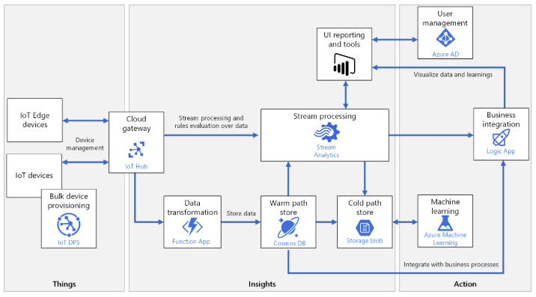
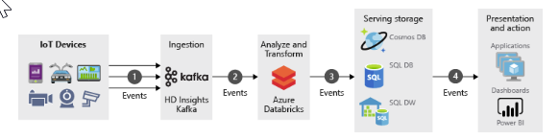
Real time analytics
Notes:
This one is possible, but there are other IOT Architectures.
Note the warm and cold path. Data transformation using Azure Functions

Slide 22
hub & Spoke architecture for bi
INGEST
STORE
PREP & TRAIN
MODEL & SERVE
Data Marts
Business/custom apps
(structured)
SQL
Azure Databricks
Multiple Azure SQL Database instances
Logs (unstructured)
PolyBase
Azure Data Factory
Azure Blob Storage
Azure SQL Data Warehouse
Power BI
Media (unstructured)
Data Cubes
Multiple Azure Analysis Services instances
Files (unstructured)
Video
https://azure.microsoft.com/en-us/resources/videos/connect-2017-hub-and-spoke-data-warehouses/
Notes:
SQL DW as the hub Cubes are the spike
Siloed data marts can lead to incomplete information and additional headcount cost.
A monolithic data warehouse has inherent limits.
hub-and-spoke architecture where SQL Data Warehouse acts as a hub for the data marts.
Integrate Azure Functions to fully leverage the elasticity of SQL Data Warehouse with autoscale capabilities.
Key – All queryes are answered in a timely fashion.
Not all queries are created equal
Do you need the power of MPP?
Subject area data marts, Cubes for Power BI

Slide 23
Consumption patterns
MODEL & SERVE
Pattern 1: Direct Access
PBI Direct Query
Client Tools (SSMA, Data Tools etc.)
Third-party reporting tools (Talend, Qlik etc.)
Pattern 2: Semantic Layer
Tabular models using AAS
OLAP models through SSAS
Data Marts (SQL DB, SQL VM etc.)
Pattern 3: Translation Layer
APIs for custom apps
Data Marts
SQL
Multiple Azure SQL Database instances
Azure SQL Data Warehouse
Power BI
Data Cubes
Multiple Azure Analysis Services instances
Notes:
Also

Slide 24
Suitable workloads
Analytics
Store large volumes of data.
Consolidate disparate data into a single location.
Shape, model, transform and aggregate data.
Perform query analysis across large datasets.
Ad-hoc reporting across large data volumes.
All using simple SQL constructs.
“SQL on SQL”

Slide 25
Unsuitable workloads
Operational workloads (OLTP)
High frequency reads and writes.
Large numbers of singleton selects.
High volumes of single row inserts.
SQL
Data Preparation
Row by row processing needs.
Incompatible formats (JSON, XML).
SQL
Notes:
However JSON and XML are now in preview

Slide 26
Azure SQL Data Warehouse Architecture & Overview

Slide 27


Azure SQL DW Service
A relational data warehouse-as-a-service, fully managed by Microsoft.
Industries first elastic cloud data warehouse with proven SQL Server capabilities.
Support your smallest to your largest data storage needs.
Elastic scale & performance
Market Leading Price & Performance
Powered by the Cloud
Azure
Azure
Get started in minutes
Integrated with Azure ML, PowerBI, ADB & ADF
Scales beyond petabytes of data
Cloud DW Scale-out Processing
Instant-on compute scales in seconds
Query Relational / Non-Relational
Saas
Simple billing compute & storage
Pay for what you need, when you need it with dynamic pause
Azure
Office 365
Office 365
Public
Cloud
Notes:
Dramatic pause (hahaha)
ADW’s place in the SQL Server landscape
On-premis SQL Server
APS/PDW
IaaS SQL Server
SQL DB
SQL DB Managed Instance
Hyper Scale Options
Elastic Database Options
Azure Data Warehouse

Slide 28
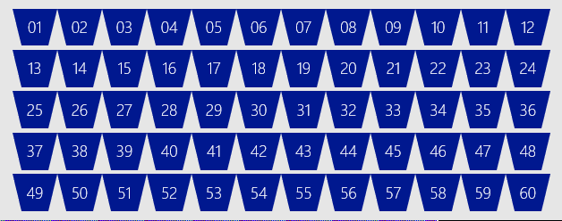
SQL DW Fundamentals
Control
Control
Connection and tool endpoint. Coordinates compute activity.
Engine
DMS
SQL DB
Compute
Handles query processing, ability to scale up/down
Compute
Compute
Compute
Compute
DMS
DMS
DMS
DMS
SQL DB
SQL DB
SQL DB
SQL DB
Dist_DB_1
Dist_DB_2
Dist_DB_15
Dist_DB_16
Dist_DB_17
Dist_DB_30
Dist_DB_31
Dist_DB_32
Dist_DB_45
Dist_DB_46
Dist_DB_47
Dist_DB_60
DMS: Data Movement Services
Coordinates data movement between nodes
…
…
…
…
Storage
Remote storage. Scales independently of compute
Blob Storage
Notes:
Compute Node VM hosting two key components of SQL DW.
These two key SQL DB and DMS.
DMS, stands for Data Movement Service
cover more later on why move data
SQL DB crunching the data and DMS moving
Third component to SQL DW, the Engine.
primary function is to optimize and manage incoming work.
Engine parses and creates query plans.
Compute node has several SQL databases.
MPP
Data is distributed into 60 distributions on storage
Each compute node is associated with a set of distributions
1 Node would have all 60 distributions
60 nodes would have 1 distribution each
This example is DW500, each compute node is hosting 12 databases.
Let’s say we want to take this DW500 and scale it up to a DW1000
What happens behind the scenes?
(1) take all of the SQL Databases down, (2) add 5 more compute nodes
(3) start up the SQL DB databases again.
some of the databases are on different compute nodes
6 distributions per node rather than 12
Each Node has half the work now

Slide 29
Azure SQL Data Warehouse Architecture & Overview
Azure SQL Data Warehouse Current release notes
https://docs.microsoft.com/en-us/azure/sql-data-warehouse/release-notes-10-0-10106-0

Slide 30
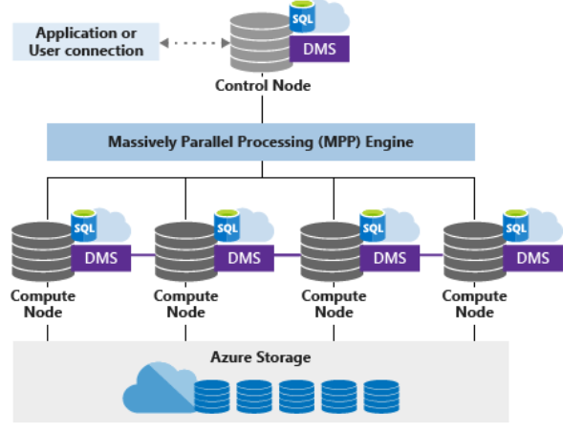
Architecture - Overview
Decoupled Storage allows:
Independently size compute power irrespective of your storage needs.
Grow or shrink compute power without moving data.
Pause compute capacity while leaving data intact, so you only pay for storage.
Resume compute capacity during operational hours.
Reference - https://docs.microsoft.com/en-us/azure/sql-data-warehouse/massively-parallel-processing-mpp-architecture

Slide 31
Architecture - Overview
Overview
SQL Data Warehouse uses a node-based architecture.
Applications connect and issue T-SQL commands to a Control node, single point of entry
The Control node runs the MPP engine which optimizes queries for parallel processing, and then passes operations to Compute nodes to do their work in parallel.
The Compute nodes store all user data in Azure Storage and run the parallel queries.
The Data Movement Service (DMS) moves data across the nodes as necessary to run queries in parallel and return accurate results.

Slide 32
Architecture – Azure Storage
Overview
Data is stored and managed by Azure storage
The data itself is sharded into distributions to optimize the performance of the system.
You can choose which sharding pattern to use to distribute the data when you define the table. SQL Data Warehouse supports these sharding patterns:
Hash
Round Robin
Replicate

Slide 33
Architecture – Control Node
Overview
The brain of the data warehouse
The front end that interacts with all applications and connections.
MPP engine runs on the Control node to optimize and coordinate parallel queries.
The Control node transforms a submit a T-SQL query into queries that run against each distribution in parallel.

Slide 34
Architecture – Compute Nodes
Overview
Provide the computational power.
Distributions map to Compute nodes for processing.
Scale Up compute resources, SQL Data Warehouse re-maps the distributions to the available Compute nodes which ranges from 1 to 60
Each Compute node has a node ID that is visible in system views. https://docs.microsoft.com/en-us/sql/relational-databases/system-catalog-views/sql-data-warehouse-and-parallel-data-warehouse-catalog-views?view=aps-pdw-2016-au7
Notes:
GO to the System view – DMVs are where you find the information
We will see some of those in Lab 04

Slide 35
Architecture – Data Movement Service
Overview
The data transport technology that coordinates data movement between the Compute nodes.
Some queries require data movement to ensure the parallel queries return accurate results.

Slide 36
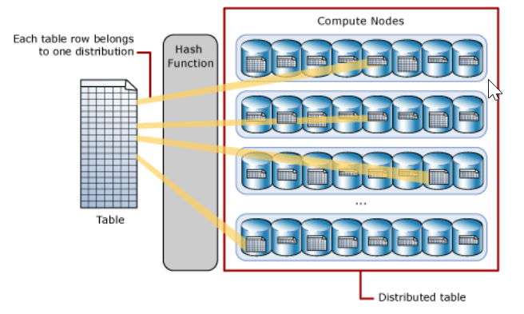
Architecture – Table Distributions
Hash Table Distributions
A hash distributed table can deliver the highest query performance for joins and aggregations on large tables.
Uses a hash function to deterministically assign each row to one distribution.
In the table definition, one of the columns is designated as the distribution column.
The hash function uses the values in the distribution column to assign each row to a distribution.

Slide 37
Architecture – Table Distributions
Round-robin distributed Table Distributions
Round-robin table is the simplest table to create and delivers fast performance when used as a staging table for loads.
A round-robin distributed table distributes data evenly across the table but without any further optimization.
Query performance can often be better with hash distributed tables.
Joins on round-robin tables require reshuffling data and this takes additional time.

Slide 38
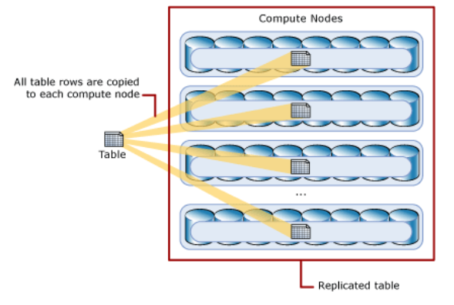
Architecture – Table Distributions
Round-robin distributed Table Distributions
A replicated table provides the fastest query performance for small tables.
A table that is replicated caches a full copy of the table on each compute node. Consequently, replicating a table removes the need to transfer data among compute nodes before a join or aggregation. Replicated tables are best utilized with small tables. Extra storage is required and there is additional overhead that is incurred when writing data which make large tables impractical.

Slide 39
SQL Datawarehouse Architecture

Slide 40
Data Warehouse Units
DWUc | Nodes | Dist/Node
100 | 1 | 60
200 | 1 | 60
300 | 1 | 60
400 | 1 | 60
500 | 1 | 60
1000 | 2 | 30
1500 | 3 | 20
2000 | 4 | 15
2500 | 5 | 12
3000 | 6 | 10
5000 | 10 | 6
…
30000 | 60 | 1
Normalized amount of compute
Converts to billing units i.e. what you pay
CPU
RAM
I/O
Notes:
Need to modify for Gen2

Slide 41
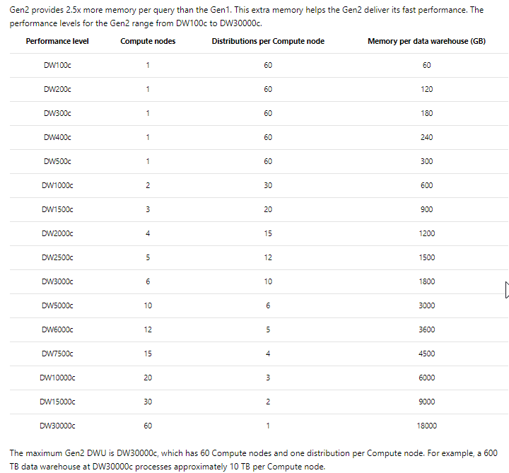
Data Warehouse Units
Normalized amount of compute
Converts to billing units
i.e. what you pay
CPU
RAM
I/O
Important to note for Labs !!
https://docs.microsoft.com/en-us/azure/sql-data-warehouse/memory-and-concurrency-limits
Notes:
This is important to note for the labs as some of the results show differences, but you have a limited amount of funds in your pass. !!

Slide 42

Separate compute from storage
SQL
Control
Compute
Premium Storage
Notes:
De-coupled storage from compute & control
Completely elastic
Pay for the data you store and the compute you provision

Slide 43
Query Execution
Result
Query
SQL
Control
Compute
Premium Storage
Notes:
More notes needed

Slide 44
Concurrent queries
QID
QID
128
active queries
1024
open sessions
QID
QID
QID
QID
How many queries and slots are running in my Azure SQL Data Warehouse?
https://blogs.msdn.microsoft.com/sqldw/2018/03/08/how-many-queries-and-slots-are-running-in-my-azure-sql-data-warehouse/
Statistics - https://docs.microsoft.com/en-us/azure/sql-data-warehouse/sql-data-warehouse-tables-statistics
Notes:
https://docs.microsoft.com/en-us/azure/sql-data-warehouse/sql-data-warehouse-concept-recommendations
GO to link on the slide

Slide 45
Concurrency slots
Concurrency Slots
20 per DW500c: 250MB/slot
4 per DW100c: 100MB/slot
Total system
available memory
Notes:
If you issue enough queries that require system resources from the distributed nodes,
Data Warehouse will queue the queries until enough system resources/concurrency slots are available.
Gen2 introduces a new NVMe Solid State Disk cache that keeps the most frequently accessed data close to the CPUs.
This removes the remote I/O for your most intensive and demanding workloads.
To ensure each query has enough resources to execute efficiently, SQL Data Warehouse tracks resource utilization by assigning concurrency slots to each query.
The system puts queries into a queue based on importance and concurrency slots. Queries wait in the queue until enough concurrency slots are available.
Importance and concurrency slots determine CPU prioritization

Slide 46
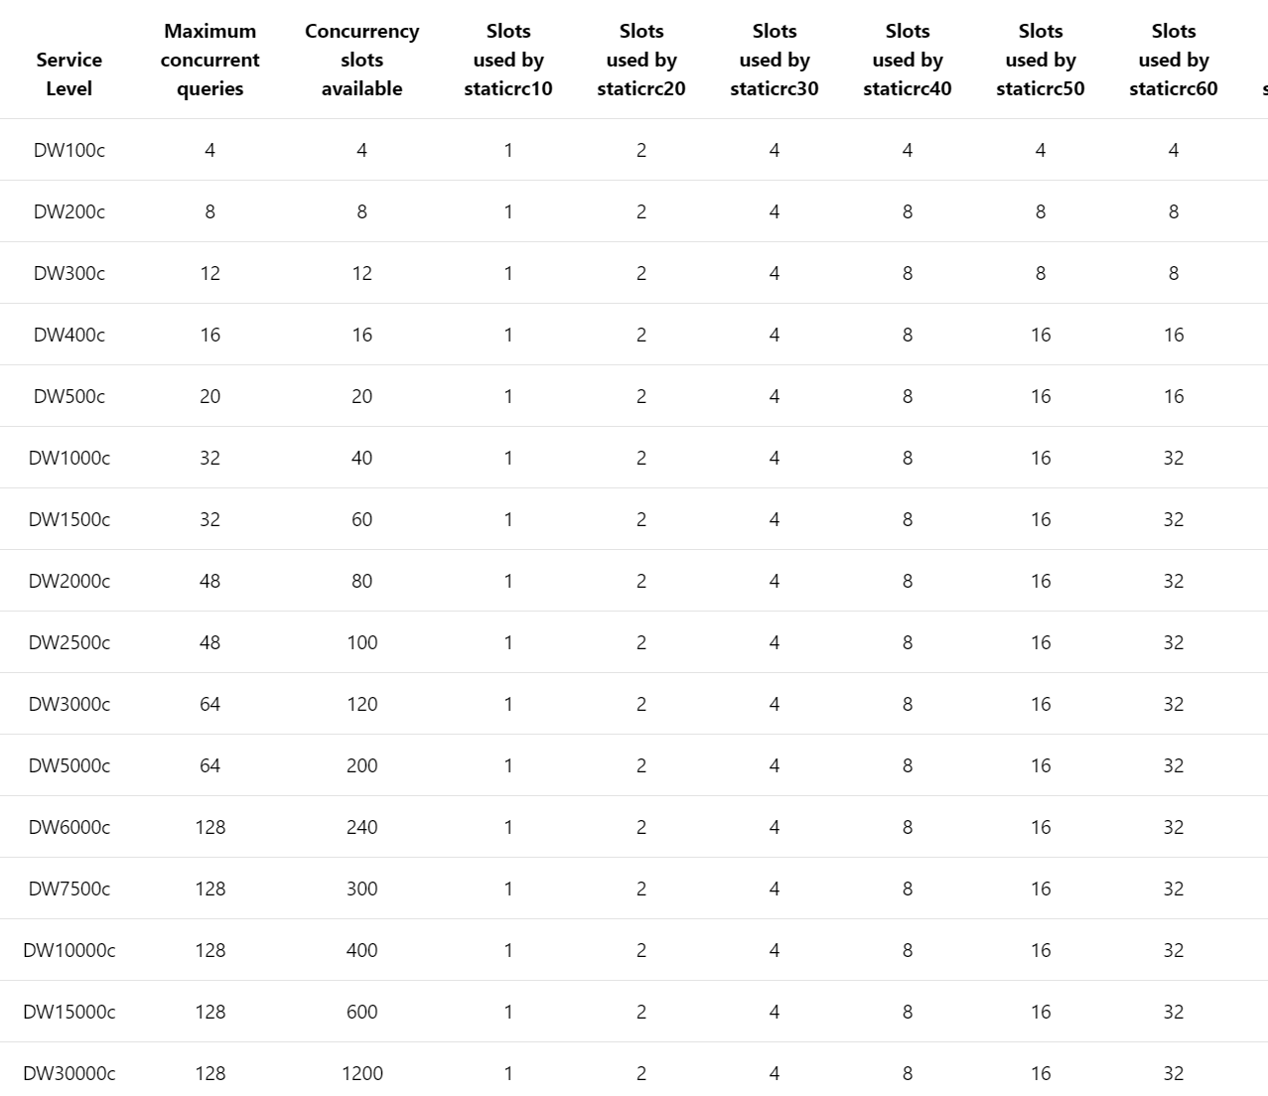
Concurrent Query and Slots
Resource Class
Memory and concurrency limits for Azure SQL Data Warehouse -
https://docs.microsoft.com/en-us/azure/sql-data-warehouse/memory-and-concurrency-limits
Notes:
Query cap = number of running queries
Slots = size of queries that are running
Review the slide and service level

Slide 47
Resource classes
Dynamic
Increases resource consumption as you scale
No increase in concurrency as you scale
Static
Maintain resource consumption as you scale
Increase concurrent queries as you scale
Consume Slots
Increase memory
Isolate resources
Notes:
Key point:
-Dynamic: as you scale, queries have more slots and ram to run faster, not more of those queries.
-Static: as you scale, queries have the same amount of slots and ram, you can run more of them.
There are two types of resource classes: Static resources classes, which are well suited for increased concurrency on a data set size that is fixed.
Dynamic resource classes, which are well suited for data sets that are growing in size and increasing performance as the service level is scaled up.

Slide 48

Resource Classes – Dynamic
Allocates variable amounts of memory depending on the scale of the DW instance.
Beneficial for variable sized workloads that scale to meet demand.
There is no increase in concurrency with scaling.
Scaling up

Slide 49
Dynamic Resource Classes
With Gen2, dynamic resource pools were introduced with a 3-10-22-70 model for resource allocations.
Resource Class | Percent Resources
SmallRc | 3%
MediumRc | 10%
LargeRc | 22%
XLargeRc | 70%
Resource Class | Percent Resources | Concurrency
SmallRc | 3% | 32
MediumRc | 10% | 10
LargeRc | 22% | 4
XLargeRc | 70% | 1

Slide 50
Resource Classes – Static
Allocates a fixed amount of memory regardless of the scale level.
Essential for high query concurrency workloads.
Queries may run the same regardless of the service level.
Scaling up

Slide 51
Gen 2 Concurrency – Static RC
Service Level | Maximum concurrent queries | Concurrency slots available | staticrc10 | staticrc20 | staticrc30 | staticrc40 | staticrc50 | staticrc60 | staticrc70 | staticrc80
DW100c | 4 | 4 | 1 | 2 | 4 | 4 | 4 | 4 | 4 | 4
DW200c | 8 | 8 | 1 | 2 | 4 | 8 | 8 | 8 | 8 | 8
DW300c | 12 | 12 | 1 | 2 | 4 | 8 | 8 | 8 | 8 | 8
DW400c | 16 | 16 | 1 | 2 | 4 | 8 | 16 | 16 | 16 | 16
DW500c | 20 | 20 | 1 | 2 | 4 | 8 | 16 | 16 | 16 | 16
DW1000c | 32 | 40 | 1 | 2 | 4 | 8 | 16 | 32 | 32 | 32
DW1500c | 32 | 60 | 1 | 2 | 4 | 8 | 16 | 32 | 32 | 32
DW2000c | 48 | 80 | 1 | 2 | 4 | 8 | 16 | 32 | 64 | 64
DW2500c | 48 | 100 | 1 | 2 | 4 | 8 | 16 | 32 | 64 | 64
DW3000c | 64 | 120 | 1 | 2 | 4 | 8 | 16 | 32 | 64 | 64
DW5000c | 64 | 200 | 1 | 2 | 4 | 8 | 16 | 32 | 64 | 128
DW6000c | 128 | 240 | 1 | 2 | 4 | 8 | 16 | 32 | 64 | 128
DW7500c | 128 | 300 | 1 | 2 | 4 | 8 | 16 | 32 | 64 | 128
DW10000c | 128 | 400 | 1 | 2 | 4 | 8 | 16 | 32 | 64 | 128
DW15000c | 128 | 600 | 1 | 2 | 4 | 8 | 16 | 32 | 64 | 128
DW30000c | 128 | 1200 | 1 | 2 | 4 | 8 | 16 | 32 | 64 | 128

Slide 52
Data Distribution

Slide 53
Table Distribution Options
https://docs.microsoft.com/en-us/azure/sql-data-warehouse/memory-and-concurrency-limits
Hash Distributed
Round Robin
(Default)
Replicated
Data divided across nodes based on hashing algorithm
Same value will always hash to same distribution
Single column only
Data distributed evenly across nodes
Easy place to start, don’t need to know anything about the data
Simplicity at a cost
Data repeated on every node
Simplifies many query plans and reduces data movement
Best with joining hash table
Check for Data Skew, NULLS, -1
Will incur more data movement at query time
Consumes more space
Joining two Replicated Table runs
on one node
Notes:
So, if I have a Product key, that product key will be used to spread the table data across the number of distribution
Note, if you have up to DW500c, you only have one node and all distributions are on one node. Remember you still have Parallel Processing
Show the links

Slide 54
Creating tables
CREATE TABLE [build].[FactOnlineSales]
(
[OnlineSalesKey] int NOT NULL
, [DateKey] datetime NOT NULL
, [StoreKey] int NOT NULL
, [ProductKey] int NOT NULL
, [PromotionKey] int NOT NULL
, [CurrencyKey] int NOT NULL
, [CustomerKey] int NOT NULL
, [SalesOrderNumber] nvarchar(20) NOT NULL
, [SalesOrderLineNumber] int NULL
, [SalesQuantity] int NOT NULL
, [SalesAmount] money NOT NULL
)
WITH
( CLUSTERED COLUMNSTORE INDEX
, DISTRIBUTION = ROUND_ROBIN
)
;
CREATE TABLE [build].[FactOnlineSales]
(
[OnlineSalesKey] int NOT NULL
, [DateKey] datetime NOT NULL
, [StoreKey] int NOT NULL
, [ProductKey] int NOT NULL
, [PromotionKey] int NOT NULL
, [CurrencyKey] int NOT NULL
, [CustomerKey] int NOT NULL
, [SalesOrderNumber] nvarchar(20) NOT NULL
, [SalesOrderLineNumber] int NULL
, [SalesQuantity] int NOT NULL
, [SalesAmount] money NOT NULL
)
WITH
( CLUSTERED COLUMNSTORE INDEX
, DISTRIBUTION = HASH([ProductKey])
)
;

Slide 55
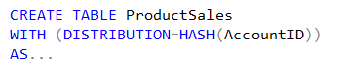
Hash Distributed
Dist_1
ProductSales – Raw Data
Dist_2
AccountID | SalesAmt | …
47 | $1,234.36 | …
36 | $2,345.47 | …
14 | $3,456.58 | …
25 | $4,567.69 | …
48 | $5,678.70 | …
37 | $6,789.81 | …
… | … | …
47 | $1,234.36 | …
Dist_3
36 | $2,345.47 | …
Hash(47)
Hash(36)
14 | $3,456.58 | …
Dist_4
25 | $4,567.69 | …
48 | $5,678.70 | …
37 | $6,789.81 | …
Dist_5
…
Dist_N

Slide 56
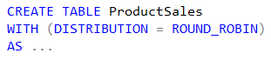
Round Robin Distributed
Dist_1
ProductSales – Raw Data
Dist_2
AccountID | SalesAmt | …
47 | $1,234.36 | …
36 | $2,345.47 | …
14 | $3,456.58 | …
25 | $4,567.69 | …
48 | $5,678.70 | …
37 | $6,789.81 | …
42 | $1,632.25 | …
88 | $4,453.21 | …
52 | $7,892.81 | ...
91 | $9,549.64 | …
66 | $2,498.14 | …
23 | $3,145.99 | …
47 | $1,234.36 | …
Dist_3
36 | $2,345.47 | …
14 | $3,456.58 | …
Dist_4
25 | $4,567.69 | …
48 | $5,678.70 | …
37 | $6,789.81 | …
Dist_5
42 | $1,632.25 | …
…
42 | $4,453.21 | …
Dist_N
52 | $7,892.81 | …
91 | $9,549.64 | …
66 | $2,498.14 | …
23 | $3,145.99 | …
Notes:
Default

Slide 57
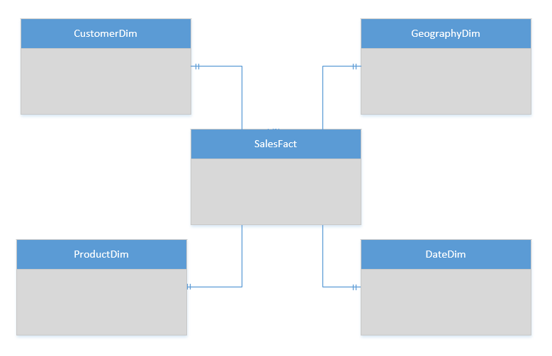
Replicated Table Scenarios
Scenarios to consider using Replicated tables:
Star schema reporting
Dimensions – descriptive entities about fact data
ETL master data, common domain data used during transaction loading
CREATE TABLE dbo.DimCustomer
( CustomerKey int NOT NULL
, GeographyKey int NULL
)
WITH
( CLUSTERED COLUMNSTORE INDEX
, DISTRIBUTION = REPLICATED
)

Slide 58
Indexing

Slide 59
Indexing Choices
Row Store : Clustered Index
Column Store : Clustered Columnstore Index (CCI)
Heap : No index
Non-Clustered Index
Notes:
https://docs.microsoft.com/en-us/azure/sql-data-warehouse/sql-data-warehouse-tables-index
CCI = default
HEAP is a keyword

Slide 60
Indexing tables
CREATE TABLE [dbo].[DimStore]
(
[StoreKey] int NOT NULL
, [GeographyKey] int NOT NULL
, [StoreName] nvarchar(100) NOT NULL
, [StoreType] nvarchar(15) NULL
, [StoreDescription] nvarchar(300) NOT NULL
, [Status] nvarchar(20) NOT NULL
, [OpenDate] datetime NOT NULL
, [CloseDate] datetime NULL
, [ETLLoadID] int NULL
, [LoadDate] datetime NULL
, [UpdateDate] datetime NULL
)
WITH
( CLUSTERED INDEX([StoreKey])
, DISTRIBUTION = ROUND_ROBIN
)
;
CREATE TABLE [dbo].[FactOnlineSales]
(
[OnlineSalesKey] int NOT NULL
, [DateKey] datetime NOT NULL
, [StoreKey] int NOT NULL
, [ProductKey] int NOT NULL
, [PromotionKey] int NOT NULL
, [CurrencyKey] int NOT NULL
, [CustomerKey] int NOT NULL
, [SalesOrderNumber] nvarchar(20) NOT NULL
, [SalesOrderLineNumber] int NULL
, [SalesQuantity] int NOT NULL
, [SalesAmount] money NOT NULL
)
WITH
( CLUSTERED COLUMNSTORE INDEX
, DISTRIBUTION = HASH([ProductKey])
)
;
Row
Column
Distribution
Notes:
When to use a
Clustered Index – smaller tables like dimensions when joins are done to single rows by key
Clustered Columnstore Index - CCI – those big tables
HEAP – when tables are small and for staging tables

Slide 61
Clustered Columnstore & Partitioning
CREATE TABLE [dbo].[FactInternetSales]
(
[ProductKey] int NOT NULL ,
[OrderDateKey] int NOT NULL ,
[CustomerKey] int NOT NULL ,
[PromotionKey] int NOT NULL ,
[SalesOrderNumber] nvarchar(20) NOT NULL ,
[OrderQuantity] smallint NOT NULL ,
[UnitPrice] money NOT NULL ,
[SalesAmount] money NOT NULL
)
WITH ( CLUSTERED COLUMNSTORE INDEX ,
DISTRIBUTION = HASH([ProductKey]) ,
PARTITION ( [OrderDateKey] RANGE RIGHT FOR
VALUES (20000101,20010101,20020101,20030101,20040101,20050101)
)
)
;
Notes:
https://docs.microsoft.com/en-us/azure/sql-data-warehouse/sql-data-warehouse-tables-partition
Loading benefits
Query benefits
Careful do not over partition
need 1000000 rows per CCI segment
each distribution is partitioned (60)
For optimal compression and performance of clustered columnstore tables, a minimum of 1 million rows per distribution and partition is needed. Before partitions are created, SQL Data Warehouse already divides each table into 60 distributed databases. Any partitioning added to a table is in addition to the distributions created behind the scenes.

Slide 62
Column Store vs Row Store - Definitions
Columnstore
A columnstore is data that's logically organized as a table with rows and columns, and physically stored in a column-wise data format.
Rowstore
A rowstore is data that's logically organized as a table with rows and columns, and physically stored in a row-wise data format. This format is the traditional way to store relational table data.
In SQL Server, rowstore refers to a table where the underlying data storage format is a heap, a clustered index, or a memory-optimized table. (Everything Else)
Rowgroup
A rowgroup is a group of rows that are compressed into columnstore format at the same time. A rowgroup usually contains the maximum number of rows per rowgroup, which is 1,048,576 rows.
Delta rowgroup
A delta rowgroup is a clustered index that's used only with columnstore indexes. It improves columnstore compression and performance by storing rows until the number of rows reaches a threshold and are then moved into the columnstore.
https://docs.microsoft.com/en-us/sql/relational-databases/indexes/columnstore-indexes-overview?view=sql-server-2017

Slide 63
Column Store vs Row Store
Why should I use a columnstore index?
A columnstore index can provide a very high level of data compression, typically by 10 times, to significantly reduce your data warehouse storage cost.
Reasons why columnstore indexes are so fast:
Columns store values from the same domain and commonly have similar values, which result in high compression rates. I/O bottlenecks in your system are minimized or eliminated, and memory footprint is reduced significantly.
High compression rates improve query performance by using a smaller in-memory footprint. In turn, query performance can improve because SQL Server can perform more query and data operations in memory.
Batch execution improves query performance, typically by two to four times, by processing multiple rows together.
Queries often select only a few columns from a table, which reduces total I/O from the physical media.

Slide 64
Column Store vs Row Store
When should I use a columnstore index?
Recommended use cases:
Use a clustered columnstore index to store fact tables and large dimension tables for data warehousing workloads
Improves query performance and data compression by up to 10 times
Use a nonclustered columnstore index to perform analysis in real time on an OLTP workload.
How do I choose between a rowstore index and a columnstore index?
Rowstore indexes perform best on queries that seek into the data
When searching for a particular value, or for queries on a small range of values.
With transactional workloads because they tend to require mostly table seeks instead of table scans.
Columnstore indexes give high performance gains for analytic queries that scan large amounts of data, especially on large tables. Use columnstore indexes on data warehousing and analytics workloads, especially on fact tables, because they tend to require full table scans rather than table seeks.

Slide 65
Polybase

Slide 66
Polybase parallel load from Azure Storage
Compute Node
Azure Storage Blob (ASB)
DMS
Bridge
Control Node
Compute Node
DMS
DMS
Bridge
Compute Node
DMS
Bridge
Notes:
It is designed to enable queries across relational data stored in PDW and in non-relational Hadoop data that is stored in the Hadoop Distributed File System (HDFS),

Slide 67
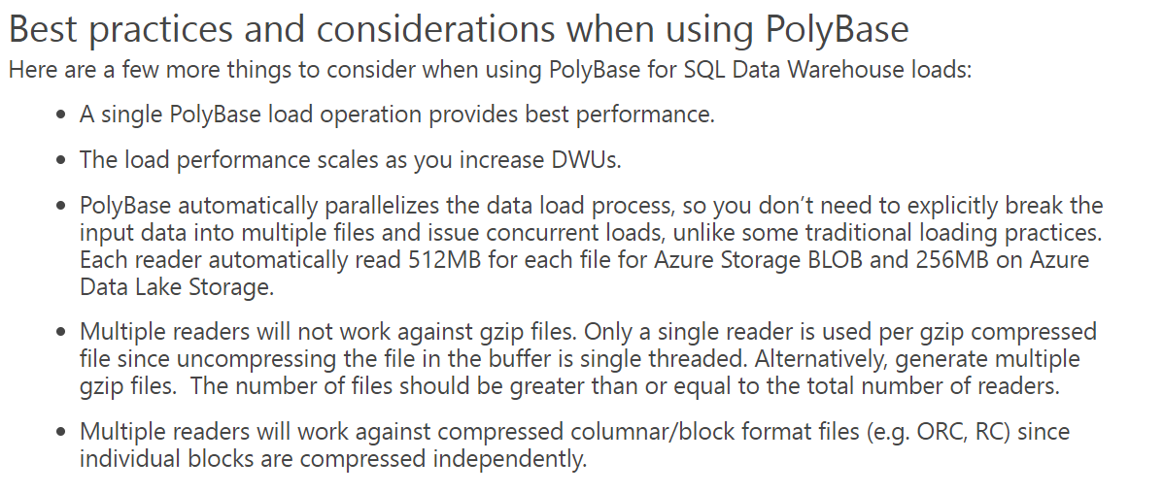
https://blogs.msdn.microsoft.com/sqlcat/2017/05/17/azure-sql-data-warehouse-loading-patterns-and-strategies/

Slide 68
Demo – Polybase examples
C:\Users\styoung\Desktop\Extra_Crecit_CreateConnectivity_Blob_Export_DW_AsExternal_Tables.sql

Slide 69
Q&A

